Slide 1

Carbon Dioxide Emissions & Temperature Correlation Shiny App
By Kristine Mitchell
DATA 824
Summer 2022

Slide 2
Dataset #1
1. Greenhouse gas emissions around the world from 1750 to 2020
From “Our World in Data” site (see sources slide)
Data set includes the different sources of greenhouse gas emissions, broken down by fuel source
Some countries have estimated data as far back as 1750
In recent years, total greenhouse gas emissions broken down by methane and nitrous oxide are included
Includes per capita breakdown for each, as well as the country’s annual global contribution for that gas
Includes population and GDP for the country for each year
Notes:
Did the presentation tell us what the data were and why they were interesting?
Was the dataset sufficiently complex and interesting enough to justify its use?
What to expect from it?
Where the data comes from?
Did the visualizations or tool created allow for interesting insight into the data?
Did the visualizations adhere to the principles?
Were violations of the principles warranted?
Did the presentation give us an interesting/compelling story about the data?

Slide 3
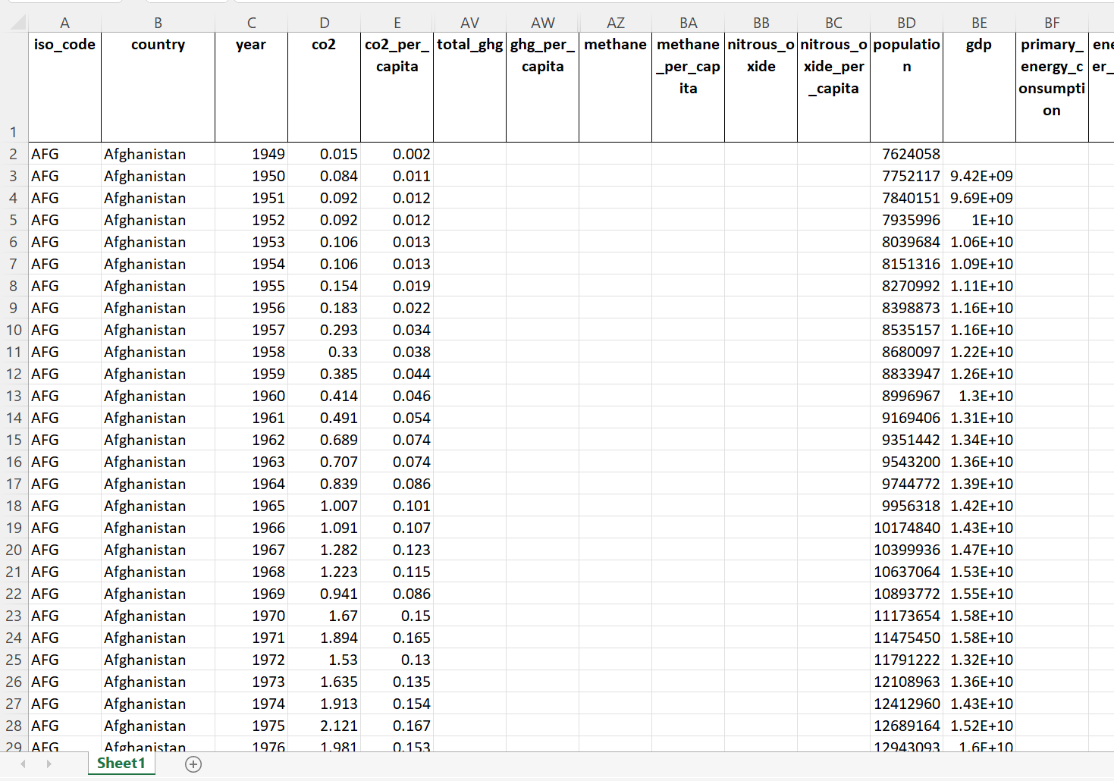
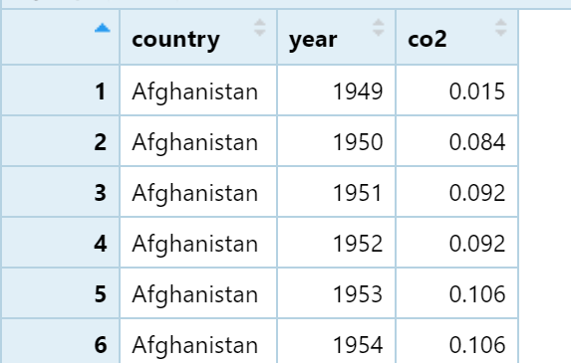
Dataset #1
Greenhouse gas emissions around the world from 1750 (for some countries) to 2020
Raw data from source
Imported into R
Notes:
Did the presentation tell us what the data were and why they were interesting?
Was the dataset sufficiently complex and interesting enough to justify its use?
What to expect from it?
Where the data comes from?
Did the visualizations or tool created allow for interesting insight into the data?
Did the visualizations adhere to the principles?
Were violations of the principles warranted?
Did the presentation give us an interesting/compelling story about the data?

Slide 4
Dataset #2
2. Global Temperature Anomalies from 1880 to 2021
From NASA (see sources slide)
Includes monthly average ambient temperatures
Data collected over both land and ocean
Temperature is given as an anomaly compared to a baseline from 1951-1980 (see NASA website for more information), so it’s not given in absolute temperatures
Notes:
Did the presentation tell us what the data were and why they were interesting?
Was the dataset sufficiently complex and interesting enough to justify its use?
What to expect from it?
Where the data comes from?
Did the visualizations or tool created allow for interesting insight into the data?
Did the visualizations adhere to the principles?
Were violations of the principles warranted?
Did the presentation give us an interesting/compelling story about the data?

Slide 5
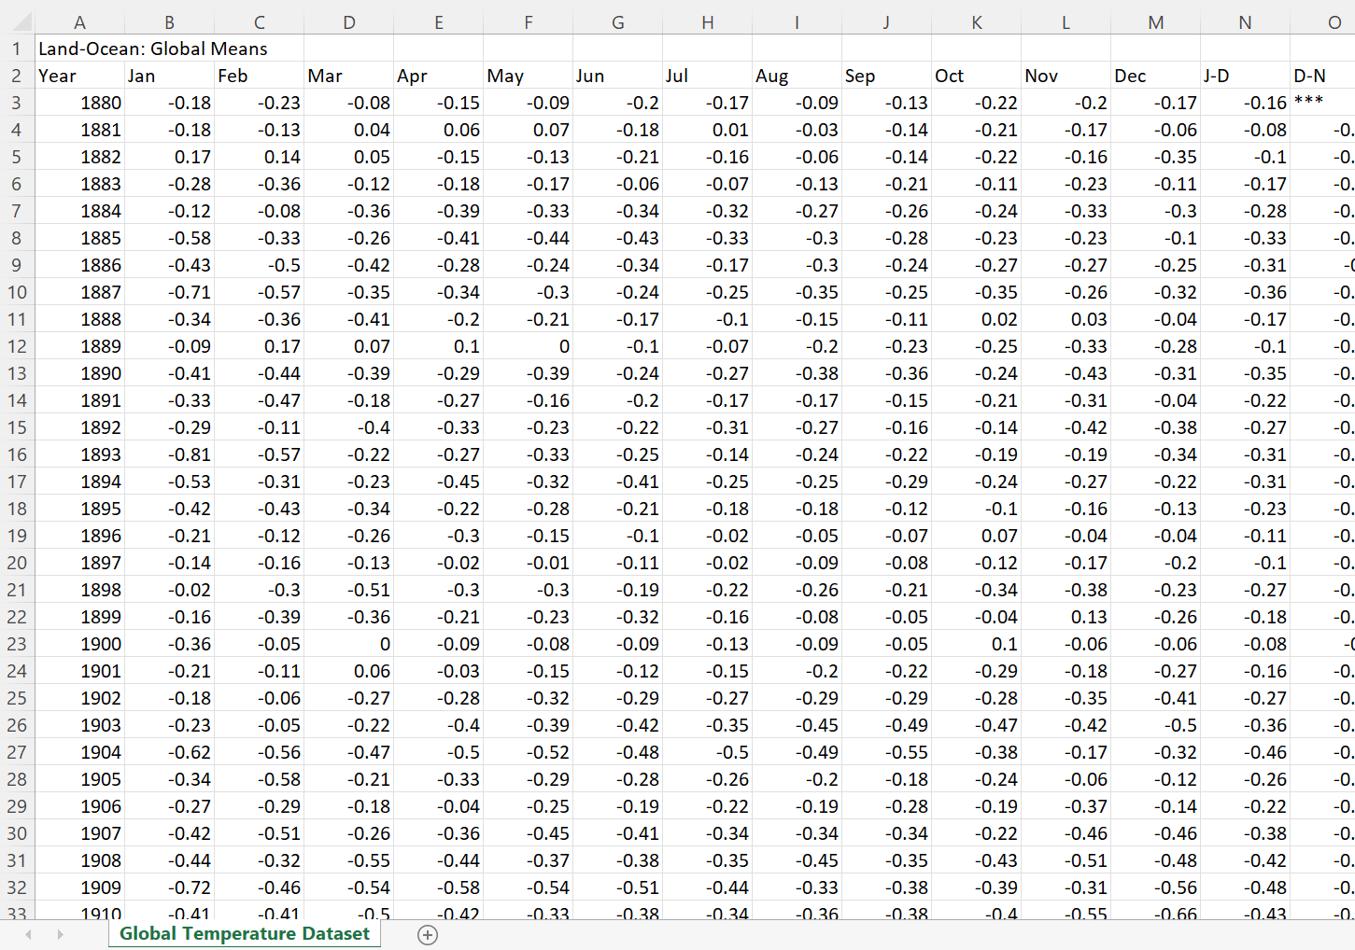
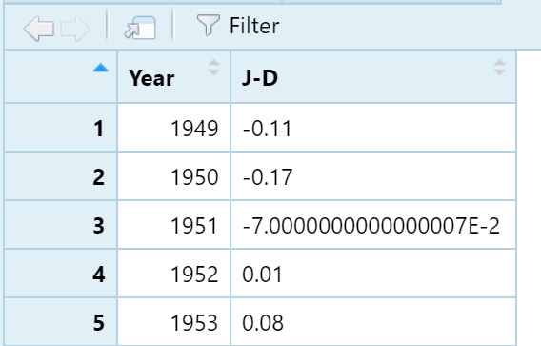
Dataset #2
Global Temperature Anomalies from 1880 to 2021
Raw data from source
Imported into R
Notes:
Did the presentation tell us what the data were and why they were interesting?
Was the dataset sufficiently complex and interesting enough to justify its use?
What to expect from it?
Where the data comes from?
Did the visualizations or tool created allow for interesting insight into the data?
Did the visualizations adhere to the principles?
Were violations of the principles warranted?
Did the presentation give us an interesting/compelling story about the data?

Slide 6
Data Wrangling
From Dataset #1, I chose to use the CO2 values for years 1880 through 2020 to match the starting year of the temperature anomaly data set.
Using R Programming, I was able to select only the “World” observations from the “country” variable in order to evaluate the global impact to match with the temperature anomaly data set.
From Dataset #2, I chose to use the temperature anomaly for each year from the January through December information and using the same range of years as Dataset #1 (1880 through 2020, to match the emissions data set).
I combined these three columns into a new data frame to use for my shiny app.

Slide 7
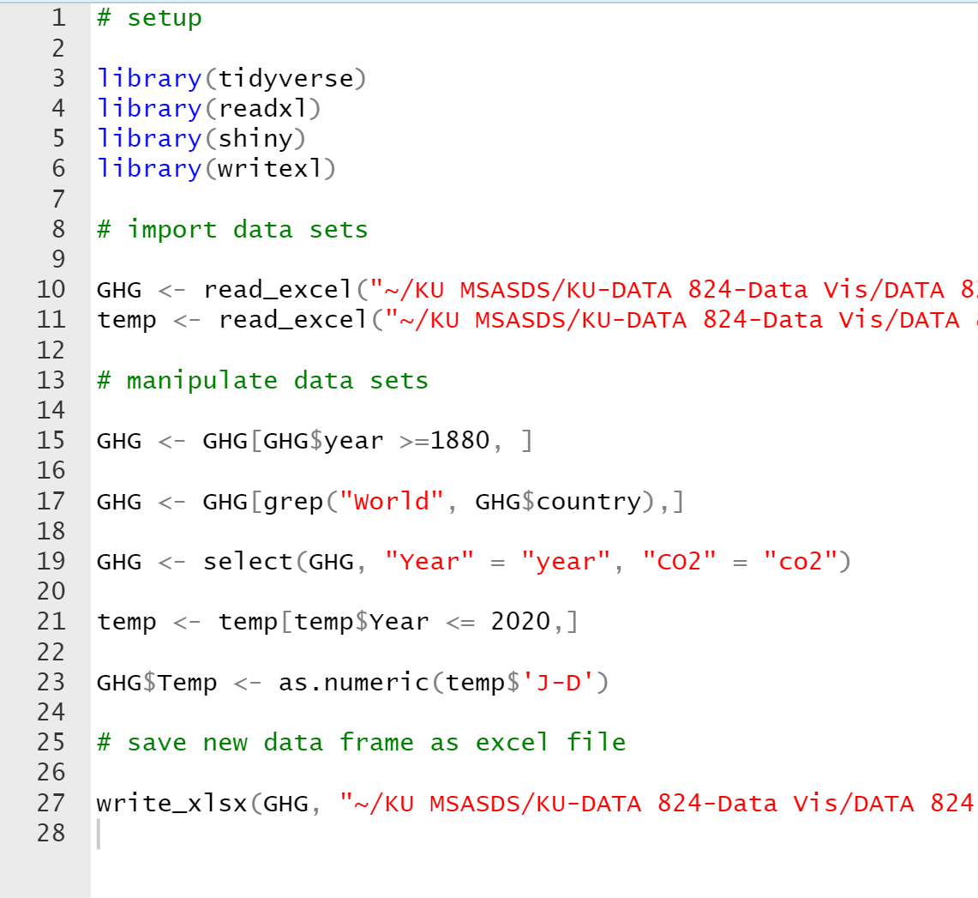
Data Wrangling
See “final script help_2.R” document for the script used for data wrangling

Slide 8
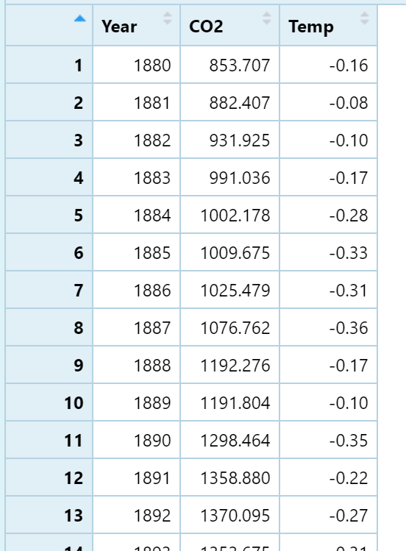
Data Wrangling
Greenhouse gas emissions around the world from 1750 to 2020
Global Temperature Anomalies from 1880 to 2021
Data frame used in Shiny App

Slide 9
Shiny App
I chose to create a Shiny R App to demonstrate the change in carbon dioxide emissions over time and the temperature anomaly over time could be visualized on different tabs.
There is also a notes tab to include more information about the data sets.
The user can input the year they want to visualize and a line on the plots will show the CO2 emissions and temperature anomaly associated with that year on each respective tab/plot.

Slide 10

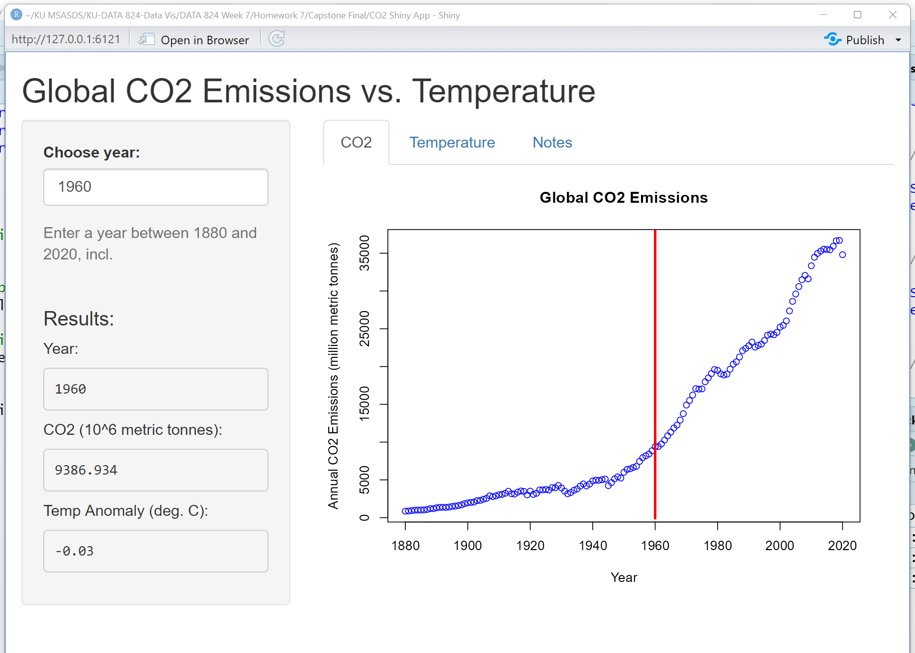
Shiny App

Slide 11
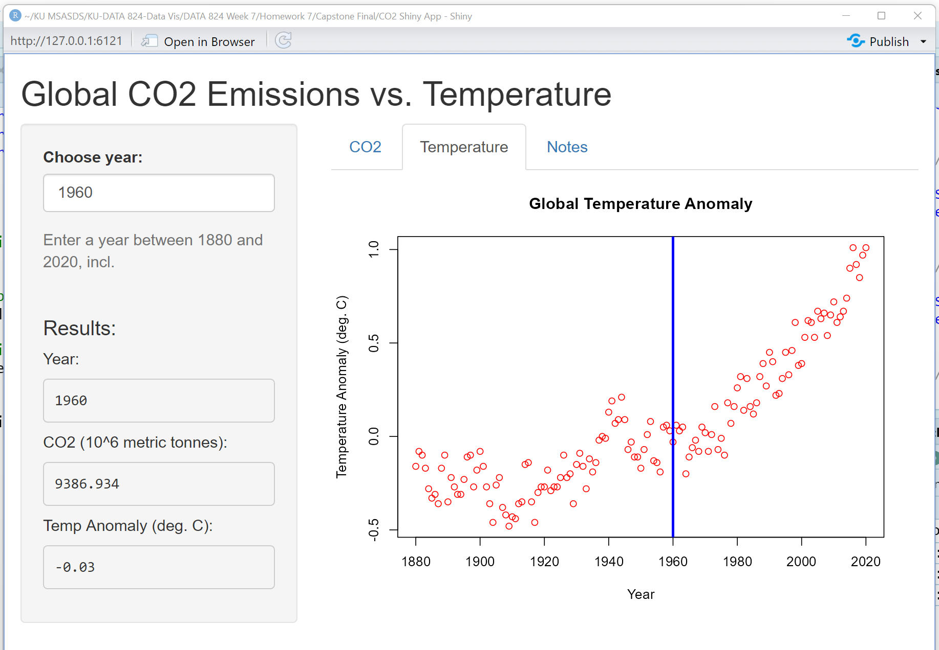
Shiny App

Slide 12
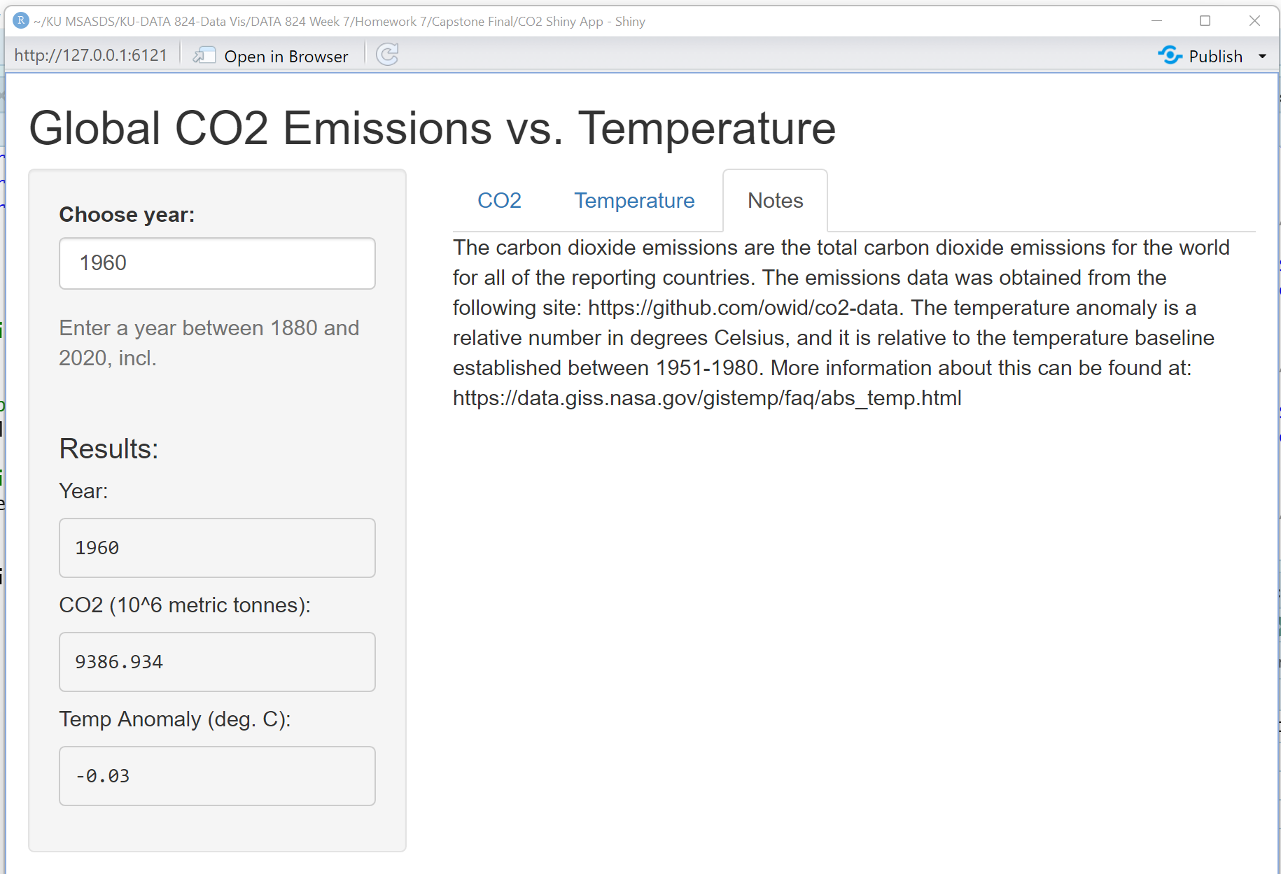
Shiny App

Slide 13

Insights
The final Shiny App is intended to provide the user with insights into the association between average carbon dioxide emissions and global temperature anomaly (change from baseline).
As CO2 emissions increase, global temperature anomaly also increase
The association and impact of increasing atmospheric CO2 emissions and the increasing global ambient temperature can be made and seen through these visualizations.
Notes:
Did the presentation tell us what the data were and why they were interesting?
Was the dataset sufficiently complex and interesting enough to justify its use?
What to expect from it?
Where the data comes from?
Did the visualizations or tool created allow for interesting insight into the data?
Did the visualizations adhere to the principles?
Were violations of the principles warranted?
Did the presentation give us an interesting/compelling story about the data?

Slide 14
GitHub Repository
The files associated with this project are located on GitHub at the following link / repository:
https://github.com/krismitch/DATA-824-Final

Slide 15
Sources
Datasets:
1. Greenhouse gas emissions
Site: https://ourworldindata.org/co2-and-other-greenhouse-gas-emissions
https://github.com/owid/co2-data
2. Global Temperature Anomalies
Site: https://data.giss.nasa.gov/gistemp/

